Slide 1

Data structures using C
Module 5 - Lecture I
Searching & Sorting
Prepared By
Ms. Smriti Sehgal

Slide 2
Syllabus
Insertion Sort, Bubble sort, Selection sort, Quick sort, Merge sort, Heap sort, Partition exchange sort, Shell sort, Sorting on different keys, External sorting. Linear search, Binary search, Hashing: Hash Functions, Collision Resolution Techniques.

Slide 3
In this session
We will talk about
Insertion sort
Bubble sort
Selection sort

Slide 4
Insertion Sort
Insertion sort is a simple comparison based sorting algorithm that works similar to the way you sort playing cards in your hands.
The array is virtually split into a sorted and an unsorted part.
Values from the unsorted part are picked and placed at the correct position in the sorted part.
Algorithm
To sort an array of size n in ascending order:
1: Iterate from arr[1] to arr[n] over the array. 2: Compare the current element (key) to its predecessor. 3: If the key element is smaller than its predecessor, compare it to the elements before. Move the greater elements one position up to make space for the swapped element.

Slide 6
Sort this using Insertion Sort
8 | 12 | 5 | 4 | 6 | 9 | 3

Slide 7
Sort this using Insertion Sort
8 | 12 | 5 | 4 | 6 | 9 | 3
8 | 12 | 5 | 4 | 6 | 9 | 3
8 | 12 | 5 | 4 | 6 | 9 | 3
8 | 5 | 12 | 4 | 6 | 9 | 3
5 | 8 | 12 | 4 | 6 | 9 | 3

Slide 8
Sort this using Insertion Sort
5 | 8 | 12 | 4 | 6 | 9 | 3
4 | 5 | 8 | 12 | 6 | 9 | 3
4 | 5 | 6 | 8 | 12 | 9 | 3
4 | 5 | 6 | 8 | 9 | 12 | 3
3 | 4 | 5 | 6 | 8 | 9 | 12
Time Complexity: O(n*2)

Slide 10
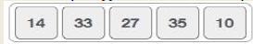
Bubble Sort algorithm
Bubble sort is a simple sorting algorithm.
This sorting algorithm is comparison-based algorithm in which each pair of adjacent elements is compared and the elements are swapped if they are not in order.
This algorithm is not suitable for large data sets as its average and worst case complexity are of Ο(n²) where n is the number of items.
How Bubble Sort Works?
We take an unsorted array for our example. Bubble sort takes Ο(n²) time so we're keeping it short and precise.
Bubble sort starts with very first two elements, comparing them to check which one is greater.

Slide 11
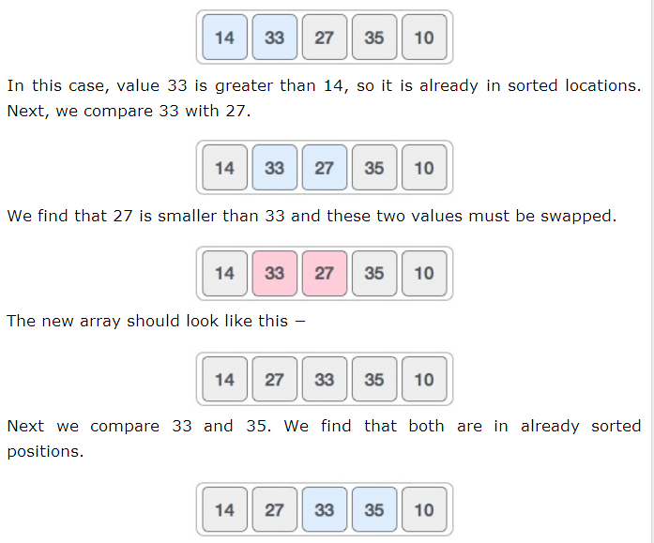

Slide 12
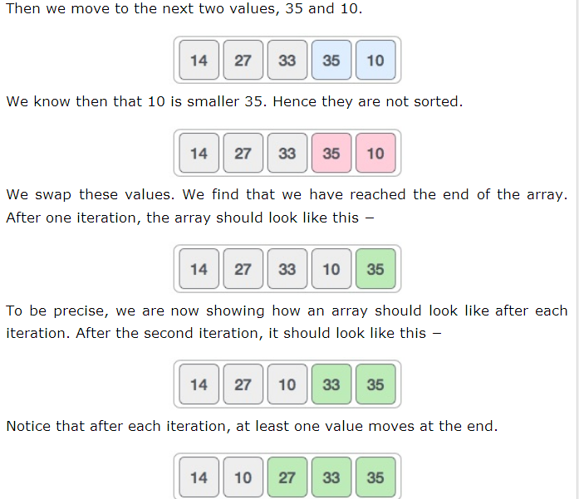

Slide 13
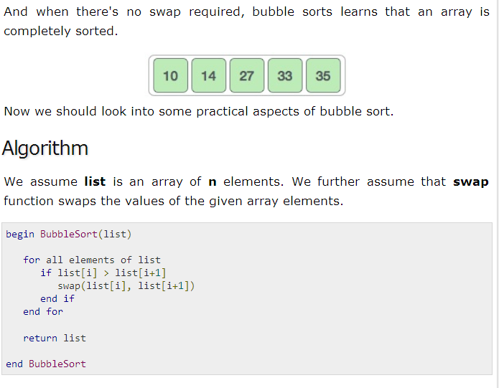

Slide 14
Sort this using Bubble Sort
8 | 12 | 5 | 4 | 6 | 9 | 3

Slide 15
Sort this using Bubble Sort
8 | 12 | 5 | 4 | 6 | 9 | 3
8 | 5 | 4 | 6 | 9 | 3 | 12
5 | 4 | 6 | 8 | 3 | 9 | 12
4 | 5 | 6 | 3 | 8 | 9 | 12
4 | 5 | 3 | 6 | 8 | 9 | 12

Slide 16
Sort this using Bubble Sort
4 | 3 | 5 | 6 | 8 | 9 | 12
3 | 4 | 5 | 6 | 8 | 9 | 12
3 | 4 | 5 | 6 | 8 | 9 | 12

Slide 17
Algorithm & Time Complexity

Slide 18
Selection Sort
The selection sort algorithm sorts an array by repeatedly finding the minimum element (considering ascending order) from unsorted part and putting it at the beginning.
The algorithm maintains two subarrays in a given array:
The subarray which is already sorted.
Remaining subarray which is unsorted.
In every iteration of selection sort, the minimum element from the unsorted subarray is picked and moved to the sorted subarray.

Slide 20
Algorithm & Time Complexity

Slide 21
Work for you….
You have been given a pack of cards (Only Spades) numbered 1 to 13 (Ace, 2 to 10, Jack Queen, King) in random order. Write a program to sort these cards. Use Bubble sort and print each line of output after every iteration.
For the same above problem, Write the program using Insertion sort and print each line of output after every iteration.
Compare the number of steps for each sorting technique

Slide 22

Web Resources
https://www.cs.usfca.edu/~galles/visualization/Search.html (Final) for linear search and binary search
https://blog.penjee.com/binary-vs-linear-search-animated-gifs/ (for linear search and binary search comparisons)
https://www.cs.usfca.edu/~galles/visualization/Algorithms.html
http://www.cs.armstrong.edu/liang/animation/web/BubbleSort.html (Bubble Sort)
http://www.ee.ryerson.ca/~courses/coe428/sorting/bubblesort.html (bUBBLE SORT)
https://courses.cs.vt.edu/csonline/Algorithms/Lessons/InsertionCardSort/insertioncardsort.swf (Insertion sort final)
http://www.ee.ryerson.ca/~courses/coe428/sorting/insertionsort.html (INSERTION SORT ADDITIONAL)

Slide 23


